Slide 1

Equations and Inequalities
simplify sums, differences, products and
quotients of algebraic fractions
solve equations and inequalities that involve
algebraic fractions

Slide 2
Simplify algebraic fractions
To add or subtract rational expression with different denominators:
Find the LCM (least common multiple) of the denominators. This is the least common denominator (LCD)
For each rational expression, find an equivalent expression with the LCD
Add the numerators. Write the sum over the LCD

Slide 3
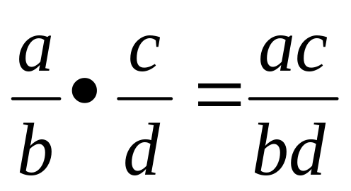
Simplify algebraic fractions
To multiply rational expressions, multiply numerators and multiply denominators

Slide 4
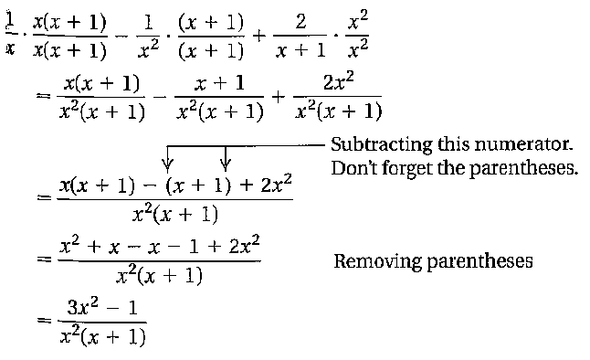
Simplify algebraic fractions

Slide 5
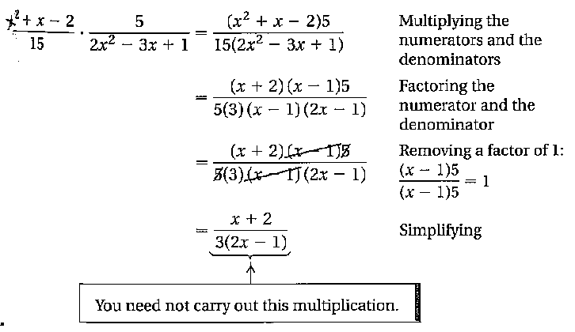
Simplify algebraic fractions

Slide 6
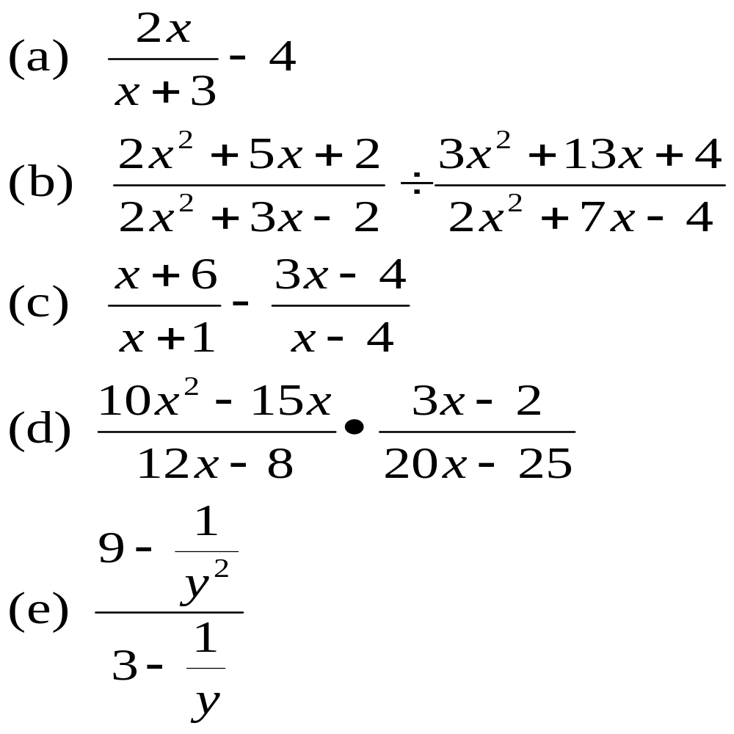
Simplify algebraic fractions
Simplify

Slide 7

Solving algebraic fractions equations
To solve a rational equations, the first step is to
clear the equation of fractions
To do this, multiply all terms on both sides of the
equation by the LCM (least common multiple) of
all the denominators
numerator
denominator

Slide 8
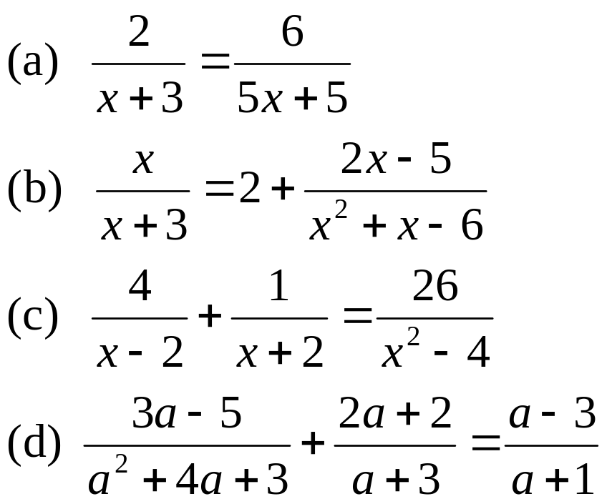
Solving algebraic fractions equations
Example:
Solve

Slide 9
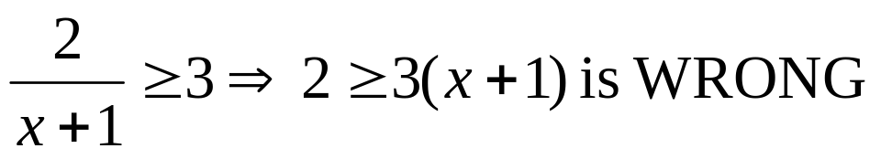

Solving algebraic fractions inequalities
Remark:
In solving inequalities, do not multiply the variables to the other
Side. Example:
Rewrite the inequality so that 0 appears on the right hand side of the inequality
On a number line, identify for each factor of the numerator and each factor of the denominator the regions where the factor is positive and those where the factor is negative
Then, find the region which satisfy the inequality given

Slide 10
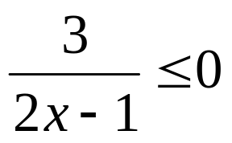
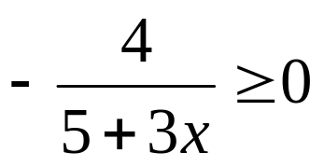
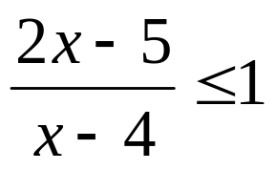
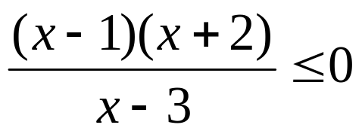
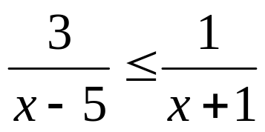
Solving algebraic fractions inequalities
Example:
(a) (b)
(c) (d)
(e)

